Slide 1
SMALL SCALE FADING
This refers to the fluctuations in signal strength and phase over short distance and small duration of time. It is also called Rayleigh Fading. Small Scale Fading affects almost all forms of wireless communication and overcoming them is a necessity to increase efficiency and decrease error.
Reasons of small scale fading:
Rapid change in signal strength over small distance
Time dispersion due to multipath delays

Slide 2
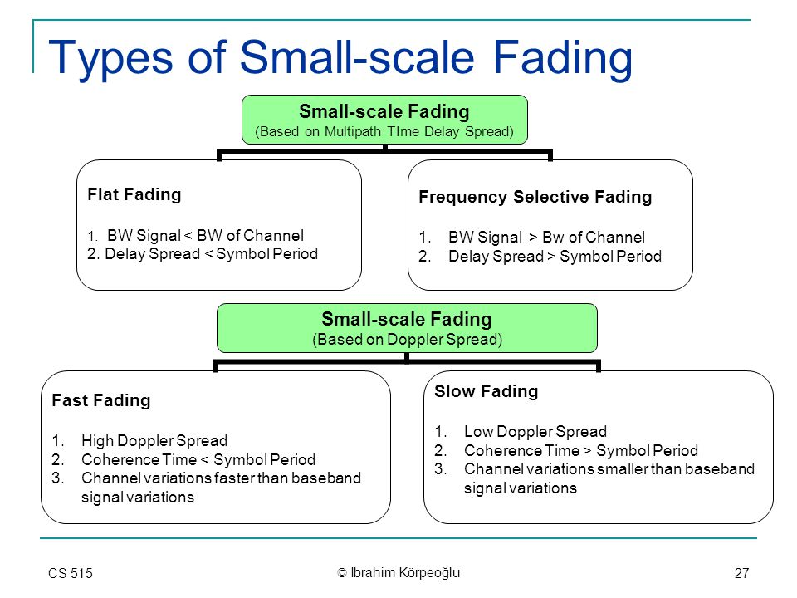
TYPES OF SMALL SCALE FADING
Types of fading experienced by Tx signal depends on the nature of Tx signal with respect to characteristics of channel

Slide 3
Fast Fading: It occurs mainly due to reflections for surfaces and movement of transmitter or receiver.
High doppler spread(spectral broadening ) is observed in the fast fading with Doppler bandwidth comparable to or greater than the bandwidth of the signal and the channel variations are as fast or faster than the signal variations
It causes linear distortions in the shape of the baseband signal and creates Inter Symbol Interference (ISI). One way to remove ISI is adaptive equalization(It is an equalizer that automatically adapts to time-varying properties of the communication channel)
Rate of change of channel is faster than rate of change of Tx signal
Doppler spread is greater than Tx signal
Ts>Tchannel (Ts- Symbol Period)
Bsignal<Bdoppler spread

Slide 4
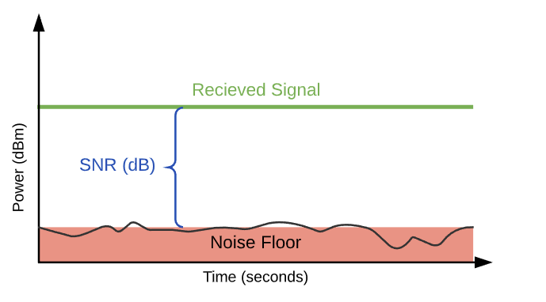
Slow Fading: It occurs mainly due to shadowing where large buildings or geographical structures obstruct the LOS(Line of sight (LOS) is the level of obstruction on the path between two points).
Low doppler spread is observed in Slow Fading with the doppler bandwidth being smaller compared to the bandwidth of the signal and the channel variations are slow relative to the signal variations.
It results in reduction of SNR(Signal-to-Noise Ratio (SNR) is the difference between the received wireless signal and the noise floor) which can be overcome using error correction techniques and receiver diversity techniques.
Rate of change of channel is slower than Tx signal
Impulse response is static
Doppler spread is smaller than Tx signal
Ts<<Tc (Tc- Coherence Time)
Bsignal>>Bdoppler (Ts- Symbol Period)

Slide 5
Multipath Fading: It occurs when a signal reaches the receiver from various path i.e. when multipath propagation takes place.
Multipath fading can affect all ranges of frequencies starting from low frequency to microwave and beyond.
It affects both the amplitude and the phase of the signal causing phase distortions and ISI.
Multipath fading can affect signal transmission in two ways:
Flat Fading: In flat fading, all frequency components get affected almost equally. Flat multipath fading causes the amplitude to fluctuate over a period of time.
Occurs in rx signal if channel has constant gain and linear phase response over Bchannel>Btransmitted signal
Frequency Selective Fading: refers to multipath fading when the selected frequency component of the signal is affected.
It means selected frequencies will have increased error and attenuation as compared to other frequency components of the same signal.
Caused due to time dispersion due to delayed multipath components
Occurs in rx signal if channel has constant gain and linear phased response over Bchannel<Bsignal

Slide 6
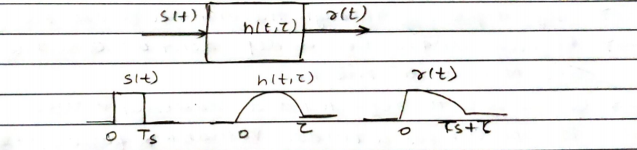
Received signal includes faded and delayed signal hence signal is distorted and Intersymbol Interferences is induced

